Slide 1

Gemini Landmark Description App
Enhancing tourist experiences with AI-powered landmark insights.

Slide 2
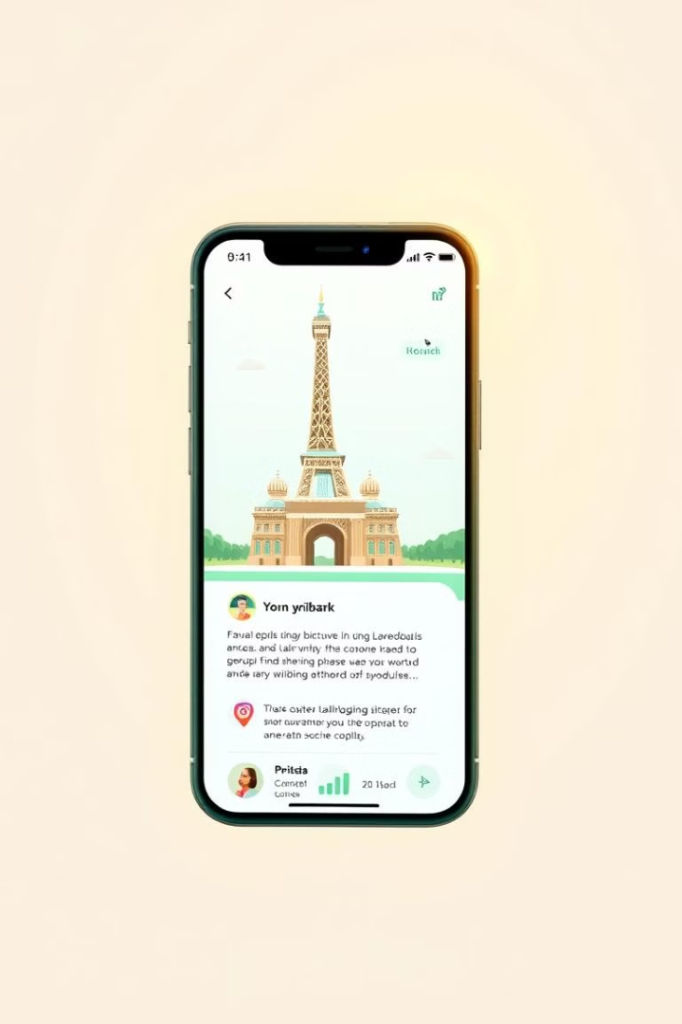
Gemini App: AI Solution
Gemini App provides AI landmark descriptions. It transforms tourist experiences.
AI-Powered Insights
Real-Time Updates
Delivers comprehensive landmark data.
Provides current info on historical sites.
Multilingual Support
Caters to diverse tourists.

Slide 3
Tourist Frustrations
Tourists often face limited landmark info. Incomplete details can mar experiences.
Limited Information
Language Barriers
Lack of detailed landmark descriptions. This can lead to superficial visits.
Information only available in one language. Exclusion of international tourists.

Slide 4
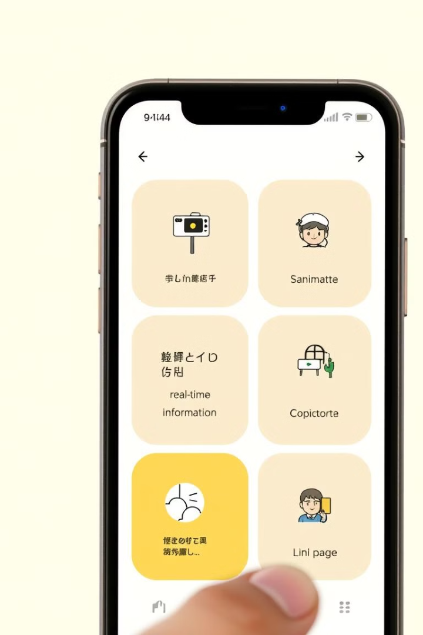



App Key Features
Key features enhance user experience. Image recognition offers convenience.
Image Recognition
Real-Time Info
Multi-Language
Access current landmark details.
App available in multiple languages.
Instant landmark identification with photos.

Slide 5
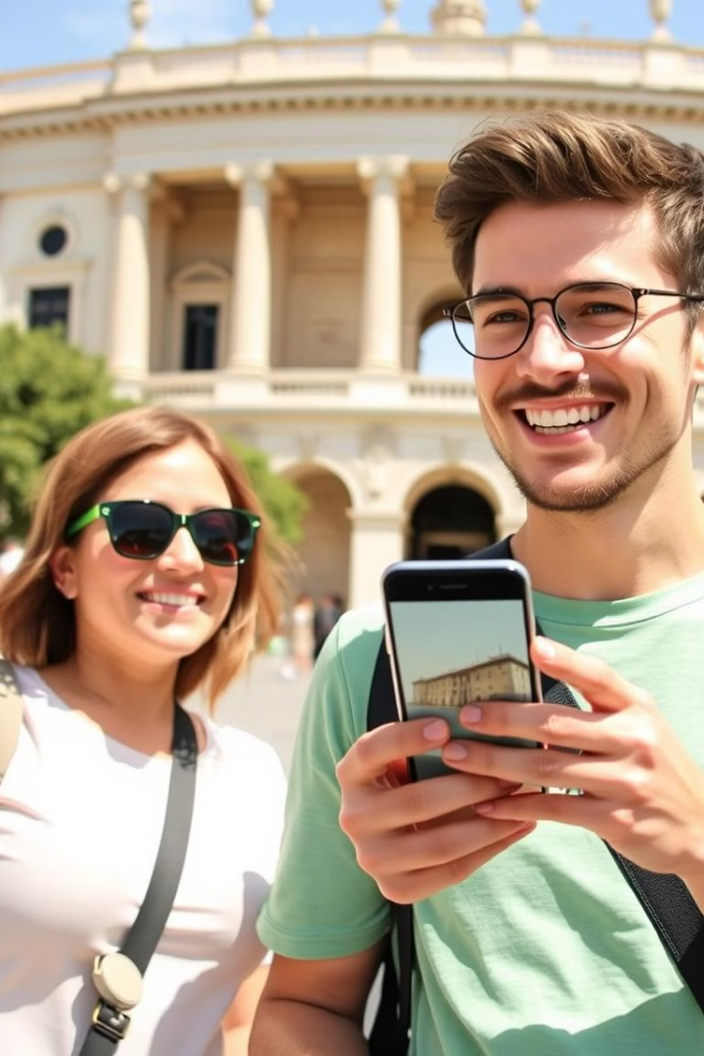




Use Case Scenario
A tourist uses the app to explore. See how it enhances their journey.
Photo Capture
Tourist captures landmark photo.
Instant Identification
App identifies the landmark instantly.
Information Access
Tourist accesses rich historical data.
Personalized Tour
Tourist enjoys a customized experience.

Slide 6



Tech & Development
Gemini AI powers the app. The UI is user-friendly.
2
Data Sources
1
Gemini AI
User Interface
3

Slide 7
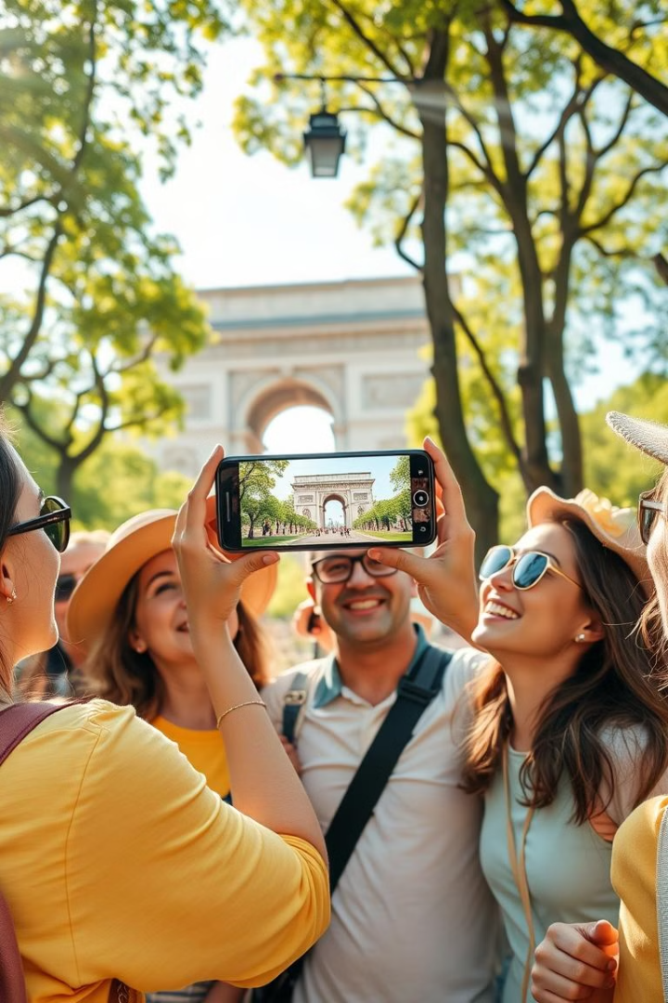
App Benefits
The app delivers unique value to tourists. It improves engagement.
1
Deeper Understanding
2
Personalized Recs
Get tailored landmark suggestions.
Gain rich historical context.
3
Improved Engagement
Interactive travel experiences.

Slide 8

Future Enhancements
Exciting updates planned for the future. AR and community features.
1
AR Integration
Augmented reality features.
2
Community Features
User-generated content sharing.
3
Personalized Avatars
Tour guides tailored to user preferences.

